Slide 1

🕕 Starter - Algorithm
Kenneth needs a program that decide if a number is large, or small. Your program should ask the user to enter a number. If it is greater than 100 it should output “Large”. If it is not, it should output “small”
Write an algorithm that will do this.
Extension:
Change your algorithm to also output the next 10 numbers after the one entered. E.g. if someone enters the number 30, it should output “31, 32, 33, 34...” etc

Slide 2
🕕 Starter - Algorithm
Mabel needs a program that decide if they she has passed a test. If she gets over 150, she has passed the test.
Write an algorithm that will:
Ask Mabel to enter the score she received in her test
Output “Well done you have passed” if the score is over 150
Output “Better luck next time” if not
Extension:
Work out how many marks Mabel was away from passing, if she failed.
Keep asking for a score until Mabel passes

Slide 3

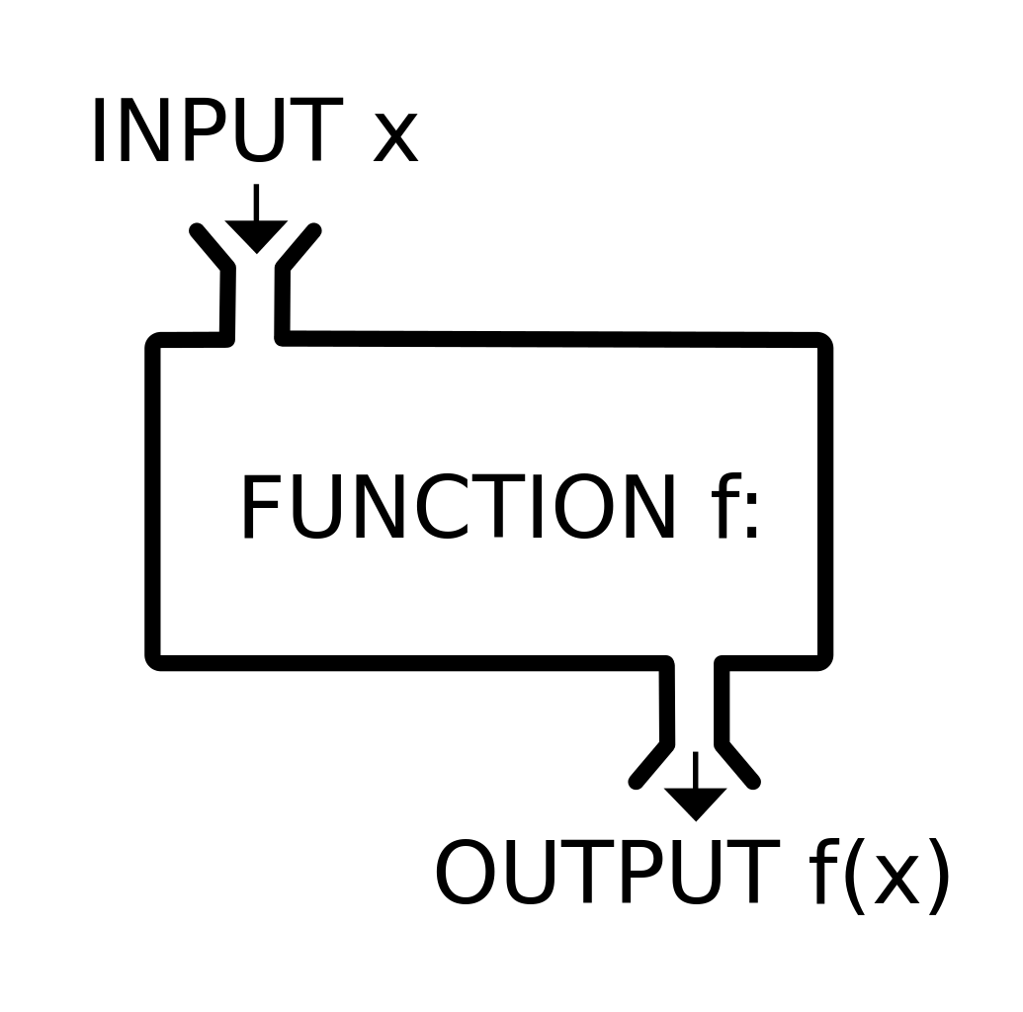


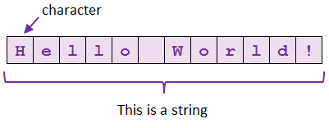
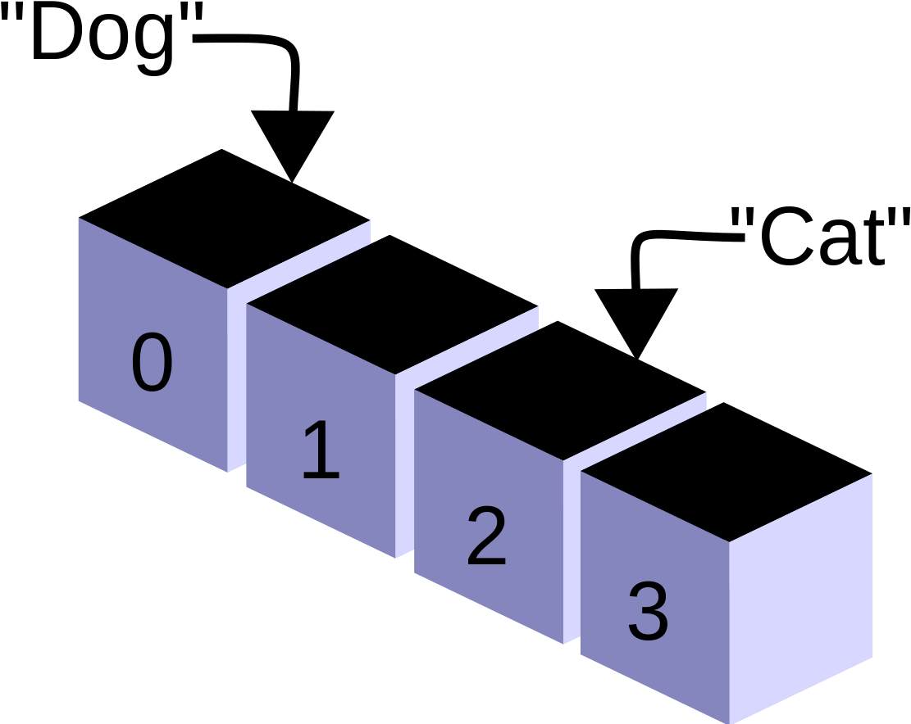


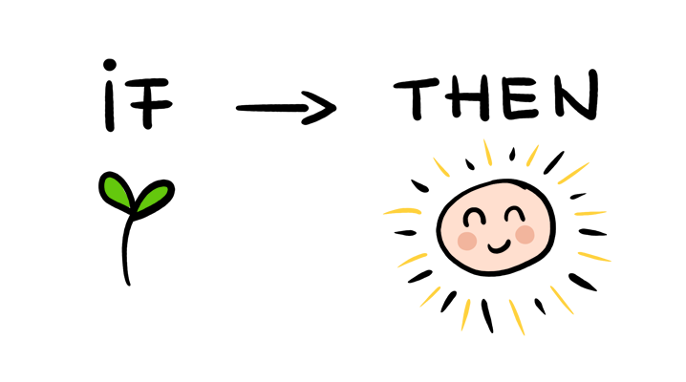
How do I write algorithms by hand?
Y11 - Algorithms
How do I write data to a file?
Practice
What are subprograms and how do I use them?
How do I use arrays?
When do I need to manipulate strings?
What are the different types of iteration?
How do I write an if statement?
Start
When should I use iteration?
How do I get input from a user?

Slide 4

Learning Outcomes
Topic Question:
How do I write algorithms by hand?
Lesson Question:
When should I use iteration?

Slide 5

Do I need iteration?
Look at the two algorithms below.
Which one uses iteration to solve a problem?
What lines of code use iteration?
number = input("Enter number")
if number > 10 then
numberPlusOne = number + 1
numberPlusTwo = number + 2
print(numberPlusOne)
print(numberPlusTwo)
endif
number = input("Enter number")
if number > 10 then
for i= 0 to 2
numberOutput = number + i
print(numberOutput)
next i
endif

Slide 6

When do I need to use iteration?

Slide 7

Speak for My Team
Out of the three scenarios below, which two need to use iteration? What is the difference between the type of iteration needed?
Michael needs a program that will take a temperature reading. It should output “Hot!” if the temperature is above 100. It should output “Normal” if not.
Michael needs a program that will take a temperature reading. It should output “Hot!” if the temperature is above 100. It should output “Normal” if not. It should keep doing so until someone enters the word “STOP” instead of a temperature.
Michael needs a program that will take a temperature reading. It should output “Hot!” if the temperature is above 100. It should output “Normal” if not. It should do this 10 times.

Slide 8
How to Setup a While Loop
Step 1 - Create a variable and set it to false
Step 2 - Use the variable to create a while loop
Step 3 - Use an if statement within the loop to set the variable to true. When to do this depends on the scenario you have been given.
1. finished = false
2. while (finished == false)
temperature = input ("Enter a temperature")
if temperature > 100
print ("Hot!")
3. finished = true
else
print ("Normal")
end if
end while

Slide 9
Try it yourself:
Ronald wants to switch on his air conditioning when the temp is above 30 degrees. Write an algorithm that:
Asks for the current temperature
If the temperature is over 30, output “switch on air conditioning”
Keeps repeating this question until the air conditioning is switched on
Extension:
Keep checking the temperature until it is below 15, then output “Switch off air conditioning”

Slide 10
Try it yourself:
Alice wants to water her plants when the soil moisture level falls below 30%. Write an algorithm that:
Asks for the current soil moisture level
If the moisture level is below 30%, output "water the plants"
Keeps repeating this question until the plants are watered
Extension:
Keep checking the moisture level until it is above 70%, then output "Stop watering plants"

Slide 11
Try it yourself:
Cecil is training to run a marathon and wants a program that will tell him if he has had a good workout.
Write an algorithm that:
Asks the user how far they have run
If they have run over 5 miles, output “Well done!”. If not, output “run further!”.
Repeatedly asks for distances that have been run.
Cecil can enter “quit” at any point and the program will exit.
Extension:
Cecil’s program should keep track of the average distance for his runs, and output it when finished.

Slide 12
Try it yourself:
Barbara runs a sweet shop and wants a program that will calculate how many sweets she has in several jars.
Write an algorithm that:
Allows a user to enter any number of sweets
Adds the number of sweets entered to a running total
If Barbara adds more than 100 sweets, the program should output “watch out!”
After asking for a number of sweets, asks the question again
If Barbara enters 0 instead of a number of sweets, the program will output the total and exit
You will need to create the variable to calculate the total outside of the loop...

Slide 13
Count Controlled Iteration
Step 1 - User “for i = 0 to ???”, where ??? is the number of times you want something to repeat. This can be a variable!
Step 2 - Put next i at the end of the code that should repeat
You can use i in your code as a counter. It will change by 1 each time around the loop!
for i = 0 to 3
temperature = input ("Enter a temperature")
if temperature > 100
print ("Hot!")
else
print ("Normal")
endif
Next i

Slide 14
Try it yourself:
Rufus needs a program that will print out the three times tables, up to 12 x 3. It should use iteration to do so. Write the algorithm to do this.
You can include 0 x3 if you want to!
for i = 0 to 3
temperature = input ("Enter a temperature")
if temperature > 100
print (i*2)
else
print ("Normal")
endif
Next i

